Slide 1


Analysis of HR Employee Attrition using SQL
- PRADEEP K I

Slide 2
About Dataset
Employee Office Survey (Feedbacks):
Captures employee feedback data for each office location from the years 2017 to 2022.
Includes ratings or feedback scores for employees, shedding light on their performance and satisfaction levels.
Provides insights into the evolving trends in employee feedback over the specified timeframe.
Job Position Structure:
Details the organizational hierarchy and job roles within different departments.
Outlines the structure with information on departments, job levels, and specific job roles.
Serves as a reference for understanding the organization's job hierarchy and the diversity of roles available.
Office Locations (Canada and US):
Encompasses information about office locations, particularly highlighting 5 offices in Canada and 3 offices in the United States.
Includes details such as office codes, city locations, provinces (or states), and countries.
Offers a geographical perspective on the distribution of offices across North America.

Slide 3
Employee Attrition Information:
Provides insights into employee attrition, including details such as leaving years, reasons for leaving, and relieving statuses.
Helps in understanding patterns and factors contributing to employee turnover within the organization.
Acts as a valuable resource for analyzing workforce dynamics and making informed HR decisions.
Objectives
To conduct a comprehensive case study on HR employee attrition using SQL, aiming to analyze various aspects of employee turnover within the organization. By addressing key questions such as average age of departing employees, factors influencing attrition rates, departmental variations, and demographic correlations, the study seeks to provide actionable insights for HR decision-making. Through SQL queries and data analysis, the objective is to uncover patterns, trends, and potential areas for improvement in retention strategies, ultimately aiming to enhance organizational stability and employee satisfaction.

Slide 4
Questionnaire:
Find the average age of employees who left the organization in each department.
List the top 5 departments with the highest average job satisfaction among employees who have not received a promotion in the last 3 years.
Determine the percentage of employees who left the organization due to various reasons.
Find the three office location with the highest average distance from home for employees who work overtime
Find the employees with the highest monthly income in each department.
Which department has the highest and lowest attrition rates?
Do married employees have a lower attrition rate compared to single or divorced employees?
Identify the top three office locations with the highest average performance ratings for employees who joined the organization in the past three years.
What is the average monthly income of employees, grouped by their job level, within each department?
How many employees hold a degree different city, categorized by their education field

Slide 5
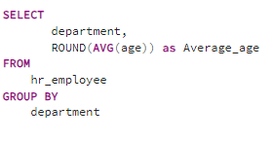
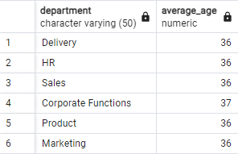
Find the average age of employees who left the organization in each department.
SQL QUERY OUTPUT
CONCLUSION: The analysis reveals a consistent average age of departure across departments, with employees leaving at an average age of 36 to 37 years. This suggests that age may not be a significant factor influencing attrition rates across different departments within the organization.

Slide 6
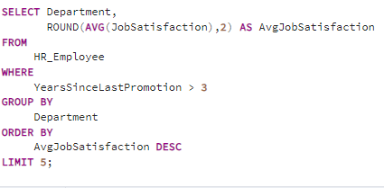
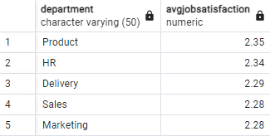
List the top 5 departments with the highest average job satisfaction among employees who have not received a promotion in the last 3 years
SQL QUERY OUTPUT
CONCLUSION : The top 5 departments with the highest average job satisfaction among employees who haven't received a promotion in the last 3 years are Product, HR, Delivery, Sales, and Marketing. This suggests that these departments have been successful in maintaining employee satisfaction despite promotion disparities.

Slide 7
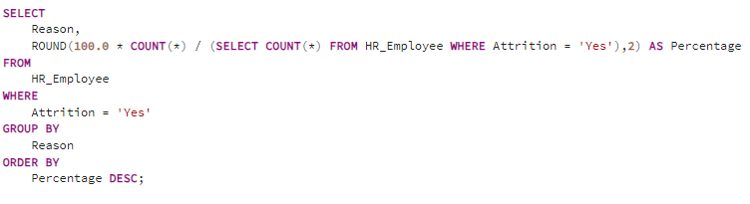
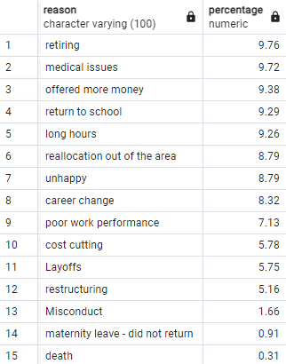
Determine the percentage of employees who left the organization due to various reasons.
SQL QUERY OUTPUT

Slide 8
CONCLUSION : From the analysis, it's evident that retiring and medical issues are the primary reasons for employee departure, each accounting for approximately 9-10% of the total attrition. Other significant factors include being offered more money, returning to school, and long hours, each contributing to roughly 9-9.5% of employee exits. Additionally, reasons such as reallocation out of the area, unhappiness, and career changes also play substantial roles, each representing around 8-9% of departures. Conversely, reasons like misconduct, maternity leave without return, and unfortunate events like death contribute to a significantly lower percentage of attrition. This breakdown highlights the multifaceted nature of employee turnover and underscores the importance of addressing various factors to mitigate attrition effectively.

Slide 9
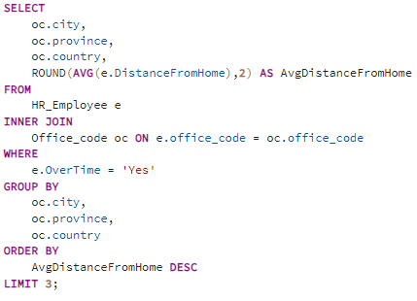
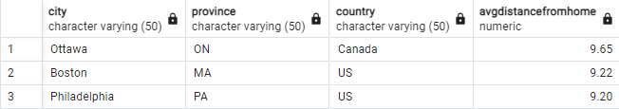
Find the top three office location with the highest average distance from home for employees who work overtime.
SQL QUERY OUTPUT
CONCLUSION : Employees working overtime in Ottawa, Boston, and Philadelphia face longer average commuting distances, indicating potential impacts on work-life balance and employee well-being. This insight underscores the importance of considering geographical factors in workforce planning to optimize employee satisfaction and productivity.

Slide 10
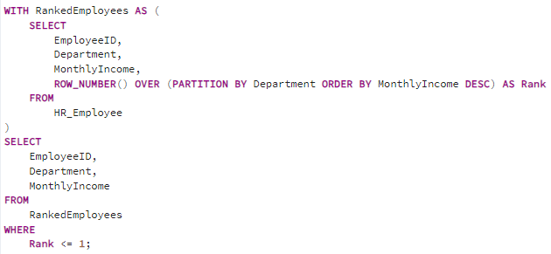
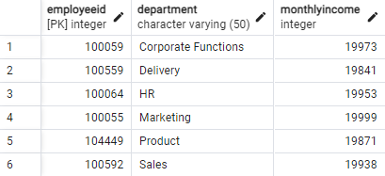
Find the employees with the highest monthly income in each department
SQL QUERY OUTPUT
CONCLUSION: The analysis identifies top earners within each department, showcasing variations in monthly income across organizational roles. This insight can inform salary benchmarking and compensation strategies to ensure competitiveness and equity within the workforce.

Slide 11
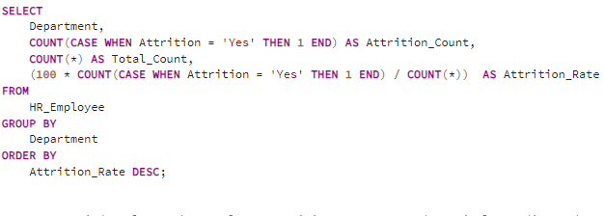
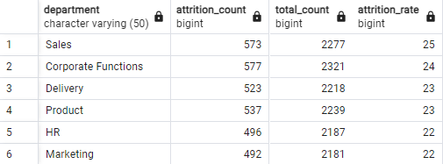
Which department has the highest and lowest attrition rates?
SQL QUERY OUTPUT
CONCLUSION : The department with the highest attrition rate is Sales with 25%, while HR and Marketing departments tie for the lowest attrition rate at 22%. This data suggests a potential need for targeted retention strategies in Sales to mitigate turnover, while HR and Marketing may benefit from analyzing factors contributing to their comparatively lower attrition rates for potential replication across other departments.

Slide 12
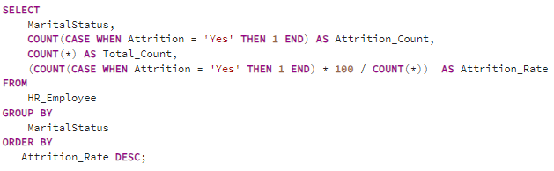
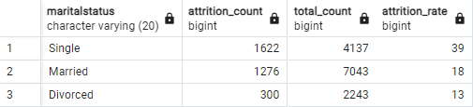
Do married employees have a lower attrition rate compared to single or divorced employees?
SQL QUERY OUTPUT
CONCLUSION : Married employees exhibit a notably lower attrition rate at 18%, compared to single employees at 39% and divorced employees at 13%. This suggests that marital status may indeed correlate with attrition rates, with married individuals demonstrating higher retention within the organization.

Slide 13
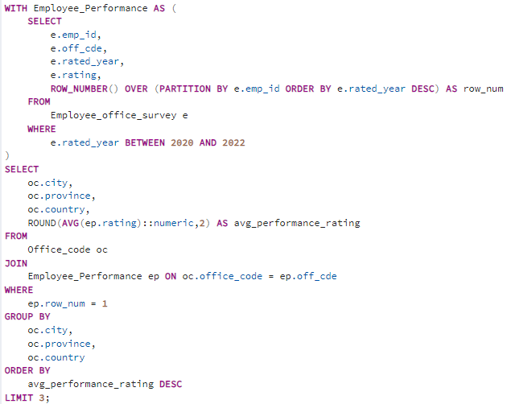
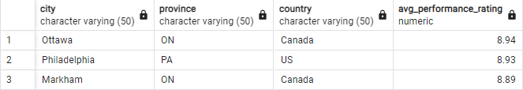
Identify the top three office locations with the highest average performance ratings for employees who joined the organization in the past three years.
SQL QUERY OUTPUT

Slide 14
CONCLUSION : The top three office locations with the highest average performance ratings for employees who joined the organization in the past three years are Ottawa, ON, Canada with an average rating of 8.94, followed by Philadelphia, PA, US with an average rating of 8.93, and Markham, ON, Canada with an average rating of 8.89. This indicates that employees in these locations, particularly those who recently joined, tend to demonstrate higher performance levels compared to other office locations.

Slide 15
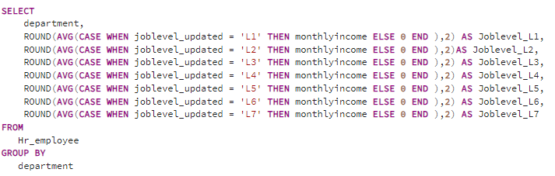
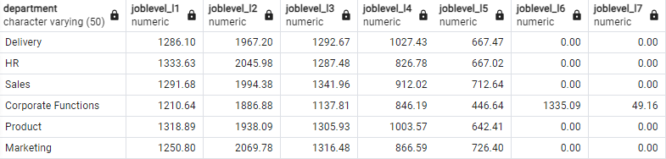
What is the average monthly income of employees, grouped by their job level, within each department?
SQL QUERY OUTPUT
CONCLUSION : The analysis reveals variations in average monthly income across different job levels within each department. Generally, higher job levels correspond to higher average incomes, as seen in the incremental pattern from L1 to L5 across departments. However, there are exceptions, such as in Corporate Functions, where L6 appears to have a notably higher average income compared to L4 and L5, suggesting unique compensation structures or roles within that department.

Slide 16
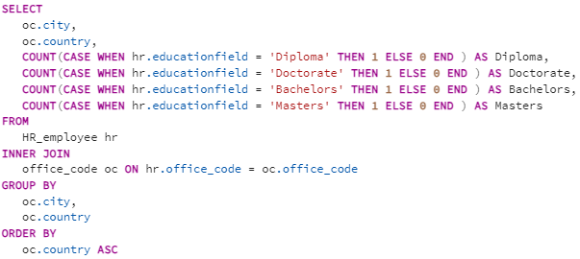
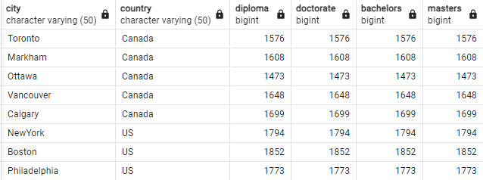
How many employees hold a degree different city, categorized by their education field
SQL QUERY OUTPUT
CONCLUSION: The output indicates the count of employees holding different degrees categorized by their education field in various cities and countries. Each city has the same count of employees across all degree categories (diploma, doctorate, bachelors, and masters). This suggests uniformity in educational qualifications among employees across different cities and countries, reflecting a consistent hiring or educational attainment pattern within the organization.

